Slide 1
SENTIMENT ANALYSIS
A look into machine learning approaches for sentiment analysis

Slide 2
Introduction
Sentiment Analysis is automatic extraction of subjective content of text and predicting the subjectivity such as positive or negative.
Subjectivity is linguistic expression of somebody’s emotions, opinion, sentiment.
Opinion Mining
Sentiment Analysis
Review Mining
Subjectivity Analysis
Sentiment Analysis
Sentence Level
Document Level
Feature Level

Slide 3
Background
Existing approaches can be classified into two categories
Keyword spotting approach
Also known as Naive Dictionary Lookup. It is the most naïve approach as it categories the text on the basis of presence of unambiguous words such as happy , sad , awesome, worst etc.
Advantages :
It is very easy to understand and implement.
Disadvantage :
Poor in classification of text with negation i.e., low accuracy. (54%)
Statistical methods.
Naïve Bayes Classifier.
Support Vector Machine (SVM).

Slide 4
Analysis of Previous Research
(Pang and Lee in 2002) [1] researched the effect of various machine learning techniques (Naïve Bayes, Maximum Entropy , and Support Vector Machines) in the specific domain of movie reviews. They were able to achieve accuracy of 82.9% using SVM (unigram model).
(Pang and Lee, 2008) [2] Gives a survey on sentiment analysis. Researchers have also analyzed the brand impact of microblogging.
. (Turney 2002) [3] Presents a simple algorithm, called sematic orientation, for detecting sentiment.
(Pang and Lee 2004) [4] Presents a hierarchical scheme in which text is first classified as containing sentiment and then classified as positive or negative.
Work has been done in using emoticons as labels for positive and negative sentiment. This is very relevant to Twitter because many users have emoticons in their tweets.

Slide 5
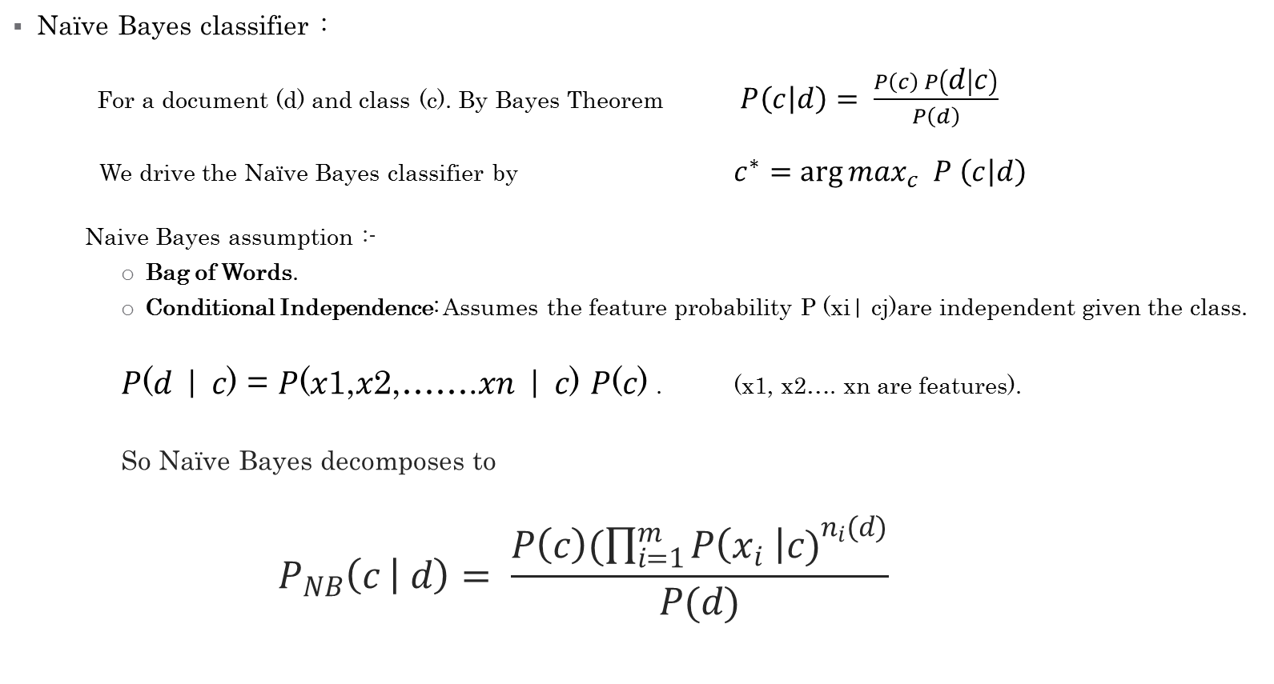
Methodology
Naïve Bayes classifier :
For a document (d) and class (c). By Bayes Theorem $P\left(c | d\right)= \frac{P\left(c\right) P\left(d | c\right)}{P\left(d\right)}$
We drive the Naïve Bayes classifier by $c^{∗}=\arg{\max_{c} P \left(c | d\right)}$
Naive Bayes assumption :-
Bag of Words.
Conditional Independence: Assumes the feature probability P (xi| cj)are independent given the class.
𝑃(𝑑 | 𝑐) = 𝑃(𝑥1,𝑥2,…….𝑥𝑛 | 𝑐) 𝑃(𝑐) . (x1, x2…. xn are features).
So Naïve Bayes decomposes to
$$P_{NB}\left(c | d\right)= \frac{P\left(c\right)(\prod_{i=1}^{m}{{P\left(x_{i} \right|c)}^{n_{i}(d)}}}{P(d)}$$

Slide 6
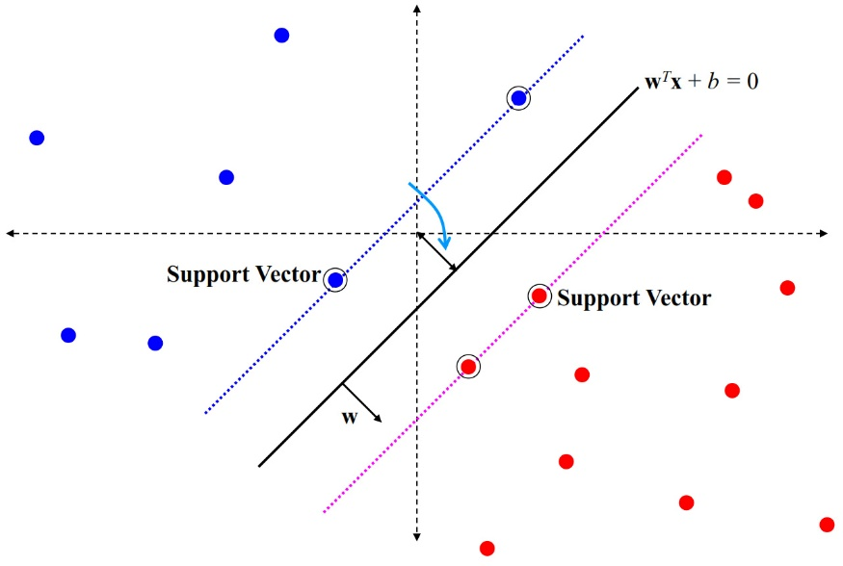
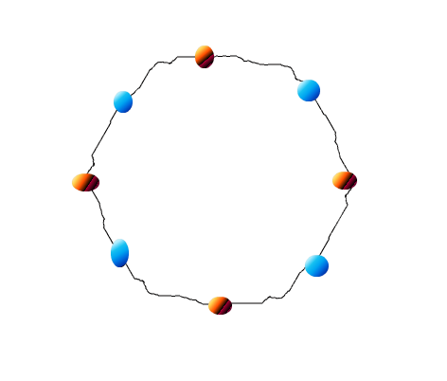
Support Vector Machine
A Support Vector Machine (SVM) is a supervised learning technique from the field of Machine Learning applicable to classification.
Some popular Kernel Functions:
Linear
Polynomial
Linearly Separable
Source: C19 Machine Learning lectures Hilary 2014
Non-Linearly Separable
(Source: http://www.quora.com/What-are-Kernels-in-Machine-Learning-and-SVM)
Radial Basis
Sigmoid

Slide 7
Result

Slide 8
Limitations of Work
Sarcasm Detection is still a major issue!
Biggest Limitation of SVM lies in choice of the kernel.
Second Limitation of SVM is speed and size, both in training and testing.
An important practical question that is not entirely solved, is the selection of the kernel function parameters. Currently, known “Grid Search” for optimal parameter selection is very slow.
Doesn’t checks whether the Document actually contains a Sentiment or not.
For example: Sun is a star. This is Fact and Contains no Sentiment and hence must be rejected.
Many Reviews contains both good and points of a Movie and hence, ideally it should be appropriately reported where is movie is bad and where it’s worth watching! Or may provide a Overall Score Or provide the user with both Options.

Slide 9
Scope for Future Work
Neutral Network may prove out to be better as pointed out by Stanford Treebank research.
Develop Models which may capture Sarcasm to at least some level!
Document should first be Classified as containing sentiment or not.
Opinionated document/reviews separated from fact documents.
Get every aspect of review broken according to different sentiments embedded within review i.e. review may contain both positive and negative sentiment which should be appropriately reported.
Different Features be used along with different models like bi-grams, trigrams

Slide 10
Reference
Bo Pang, Lillian Lee and Shivakumar Vaithyanathan (2002). “ Thumbs up? Sentiment Classiﬁcation using Machine Learnin g Techniques ”. Proceedings of EMNLP 2002, pp. 79– 86.
Bo Pang and Lillian Lee, “ Opinion mining and sentiment analysis ,” Foundations and Trends in Information Retrieval 2(1-2), pp. 1–135, 2008.
Peter Turney (2002). " Thumbs Up or Thumbs Down? Semantic Orientation Applied to Unsupervised Classification of Reviews ". Proceedings of the Association for Computational Linguistics. pp. 417–424, 2002.
Bo Pang and Lillian Lee, “A Sentimental Education: Sentiment Analysis Using Subjectivity Summarization Based on Minimum Cuts'' , Proceedings of the ACL, 2004.
http://www.svms.org
http://en.wikipedia.org/wiki/Sentiment_analysis
http://en.wikipedia.org/wiki/Support_vector_machine

